Slide 1

CSC 1004: Tutorial 10
Tkinter Introduction, and Function implementation
Bo Yue
SDS, CUHK-SZ

Slide 2
Python Class (1)
class people:
#define basic(public) attribute
name = ''
age = 0
#define private attribute
__weight = 0
#initialization
def __init__(self,n,a,w):
self.name = n
self.age = a
self.__weight = w
def speak(self):
print("%s say: I %d years old。" %(self.name,self.age))
# Instantiate a class
p = people('runoob',10,30)
p.speak()

Slide 3
Python Class (2) Inheritance
class people:
name = ''
age = 0
__weight = 0
def __init__(self,n,a,w):
self.name = n
self.age = a
self.__weight = w
def speak(self):
print("%s 说: 我 %d 岁。" %(self.name,self.age))
class student(people):
grade = ''
def __init__(self,n,a,w,g):
people.__init__(self,n,a,w)
self.grade = g
def speak(self):
print("%s say: I’m %d years old，and my grade is %d"%(self.name,self.age,self.grade))
s = student('ken',10,60,3)
s.speak()

Slide 4
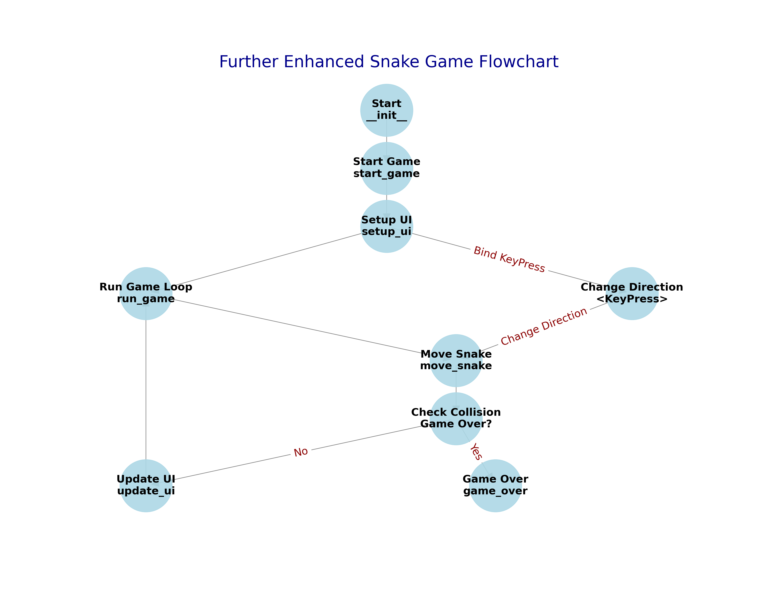
Review

Slide 5
Class SnakeGame and start_game function
class SnakeGame(tk.Tk):
def __init__(self):
super().__init__()
self.title("Snake Game")
self.geometry("800x800")
self.resizable(False, False)
self.width = 800
self.height = 800
self.cell_size = 20
self.snake_direction = 'Right'
self.snake = [(100, 100), (80, 100), (60, 100)]
self.food = self.create_food()
self.game_frame = tk.Frame(self)
self.canvas = tk.Canvas(self.game_frame, bg='black', width=self.width, height=self.height)
self.start_game()
def start_game(self):
self.game_frame.pack(fill="both", expand=True)
self.canvas.pack()
self.setup_ui()
self.run_game()
def setup_ui(self):
self.update_ui()
self.bind("<KeyPress>", self.change_direction)
def run_game(self):
self.move_snake()
self.after(100, self.run_game)

Slide 6
move_snake
def move_snake(self):
head_x, head_y = self.snake[0]
if self.snake_direction == 'Left':
head_x -= self.cell_size
elif self.snake_direction == 'Right':
head_x += self.cell_size
elif self.snake_direction == 'Up':
head_y -= self.cell_size
elif self.snake_direction == 'Down':
head_y += self.cell_size
new_head = (head_x, head_y)
self.snake = [new_head] + self.snake[:-1]
self.update_ui()
You should also consider the timestep of eatting food and collision in this function.

Slide 7
Create food and game over
def create_food(self):
while True:
x = random.randint(0, (self.width//self.cell_size)-1) * self.cell_size
y = random.randint(0, (self.height//self.cell_size)-1) * self.cell_size
food = (x, y)
if food not in self.snake:
return food
def game_over(self):
self.canvas.create_text(self.width//2, self.height//2, text="Game Over", fill="white", font=('TkDefaultFont', 24))
self.unbind("<KeyPress>")

Slide 8
THE END
THANKS

